Slide 1
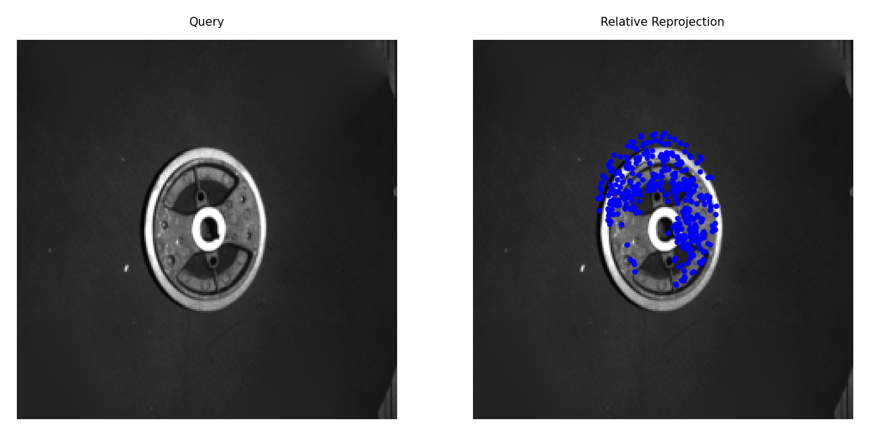
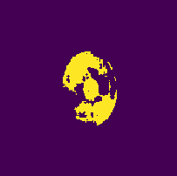
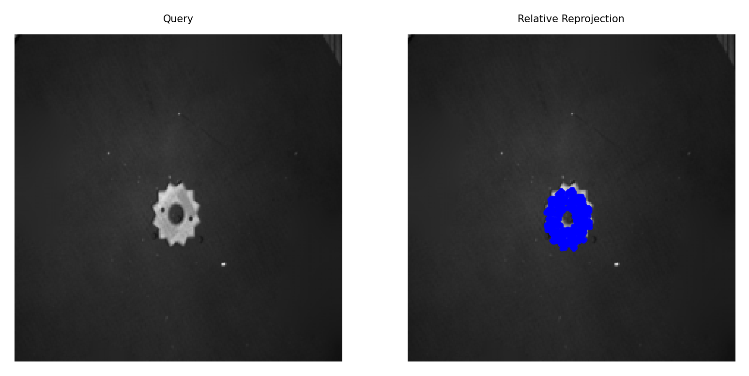
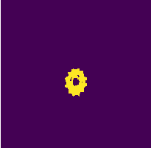
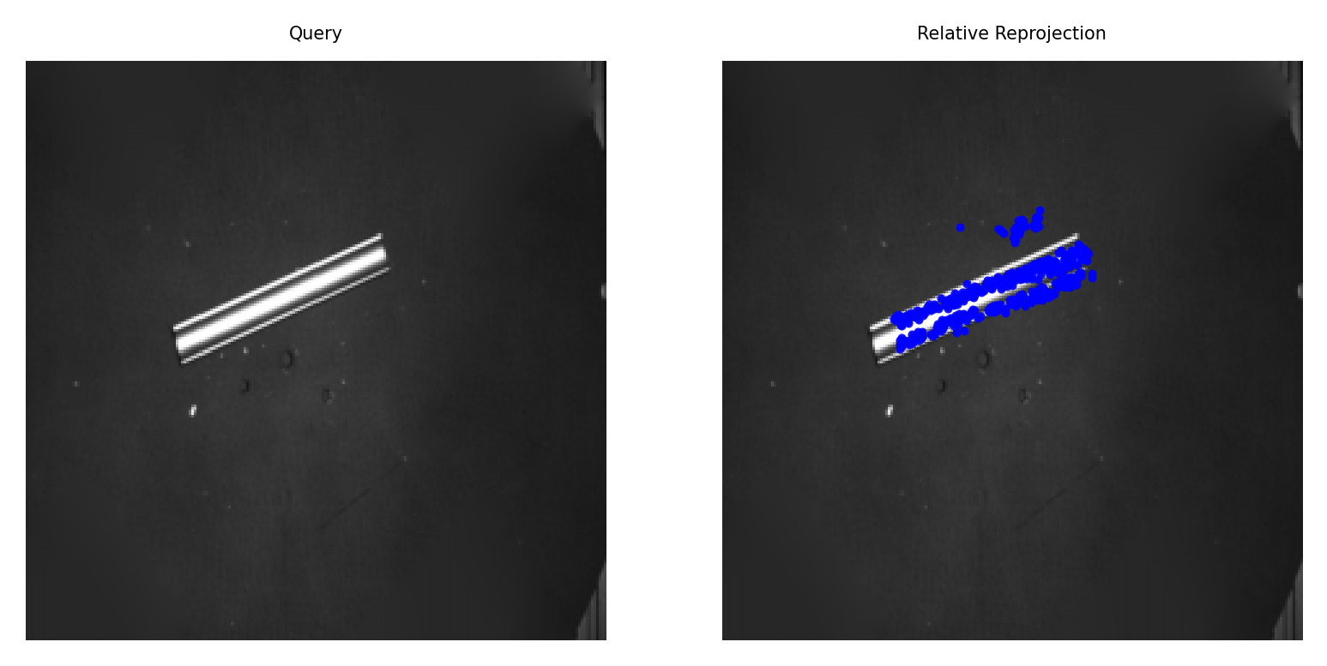
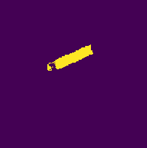
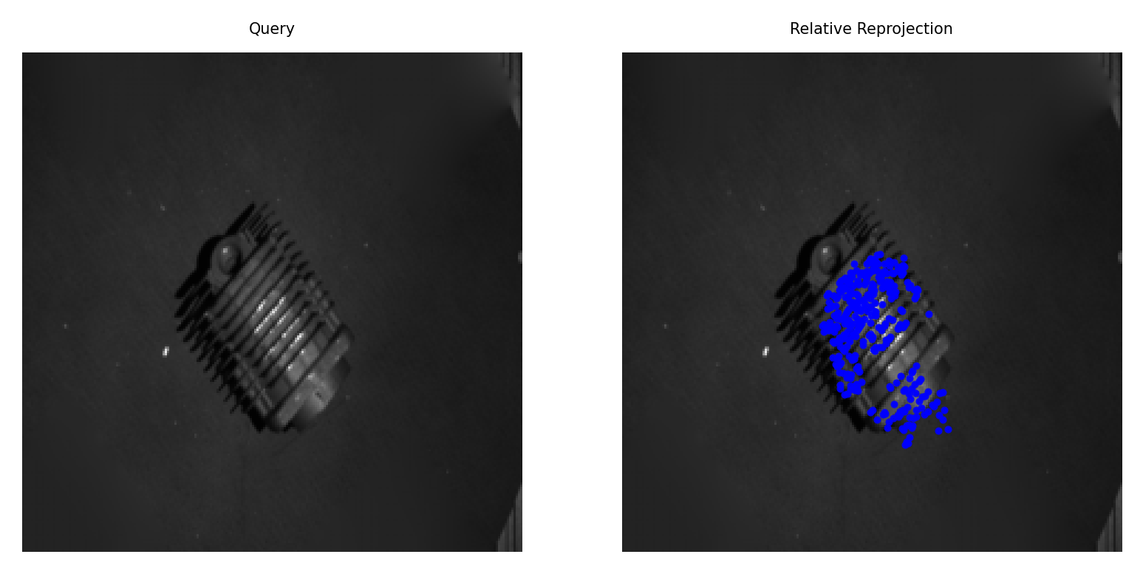
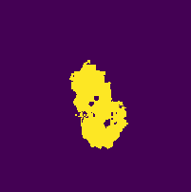
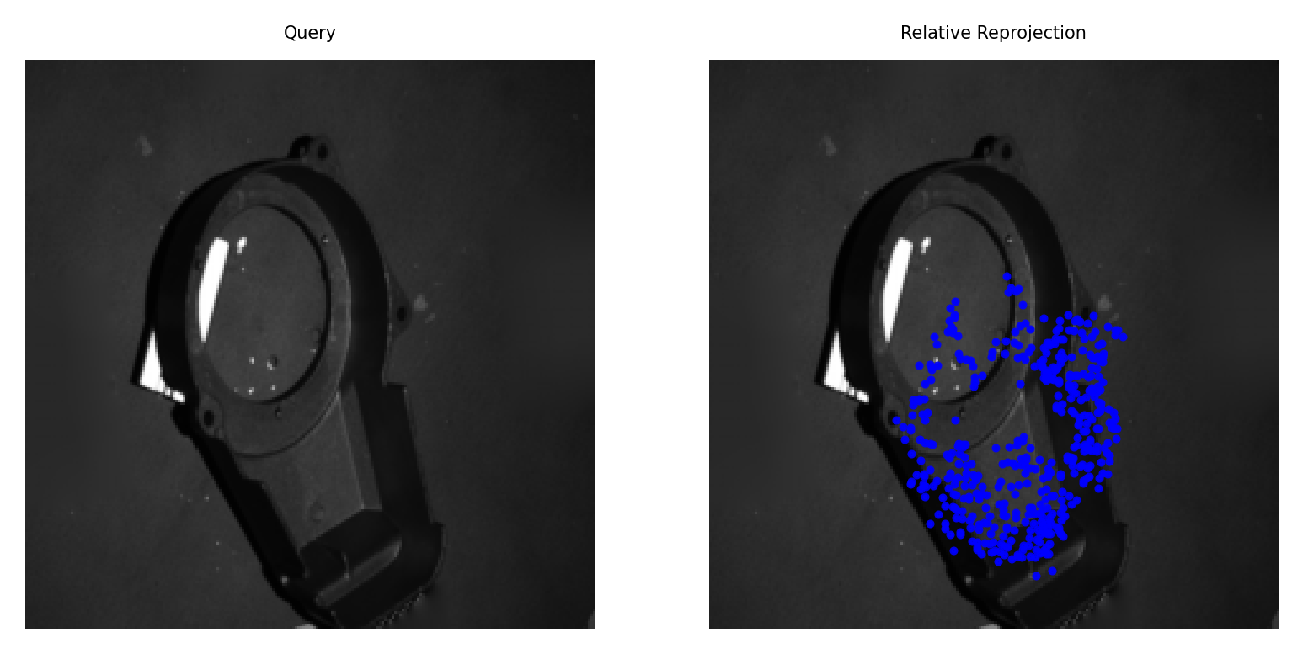
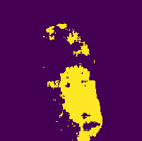
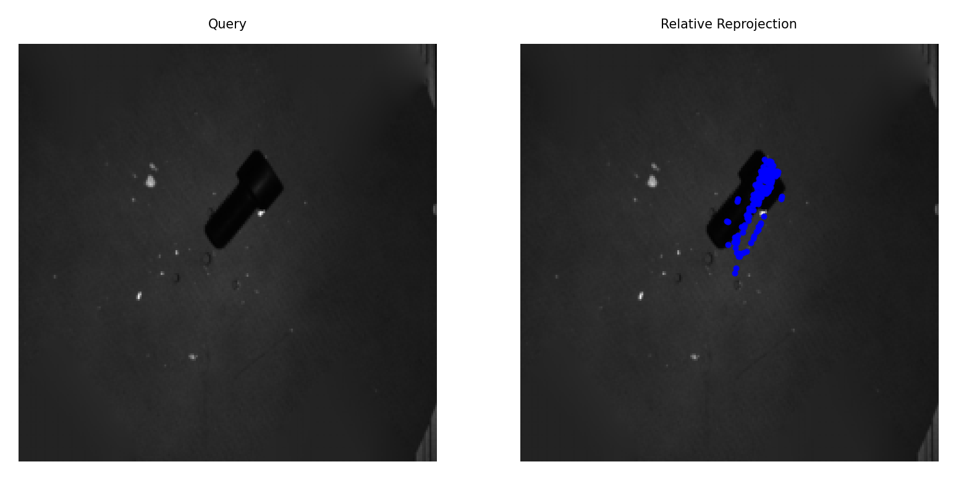
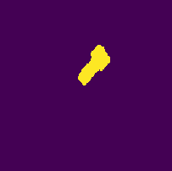
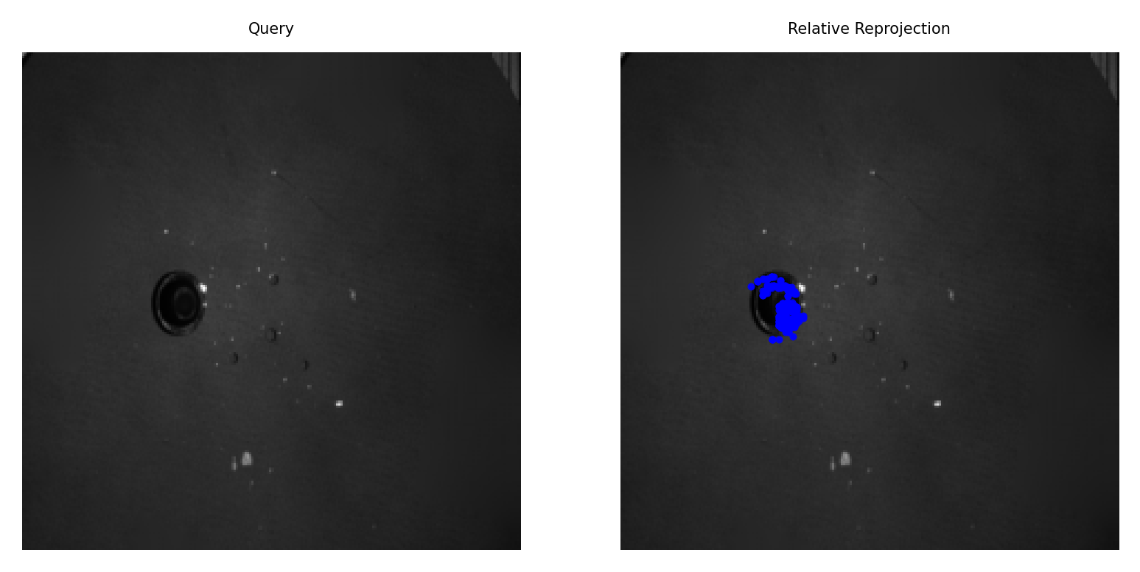
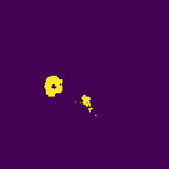
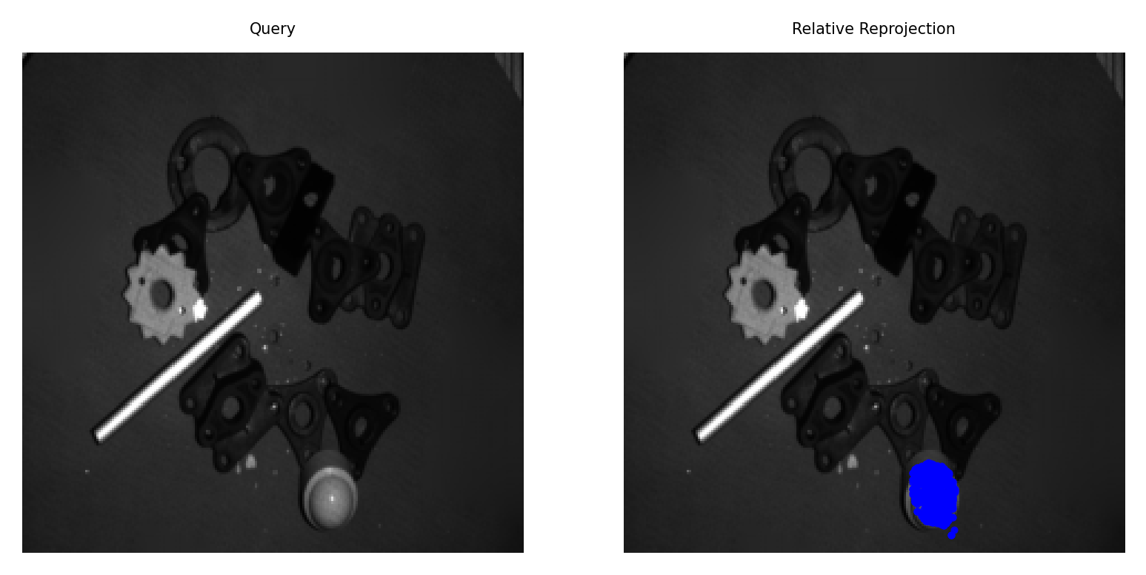
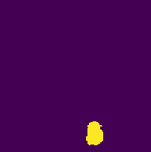
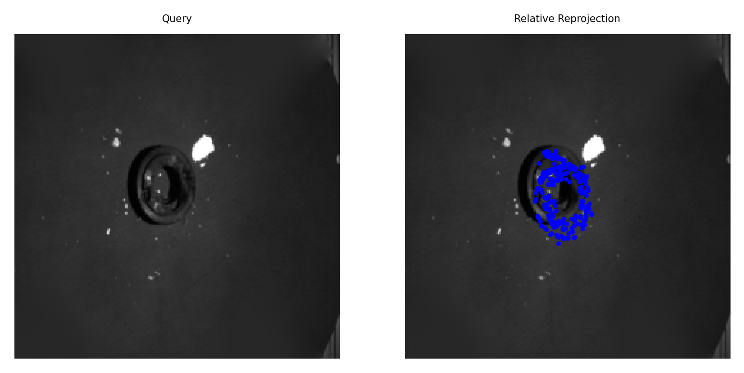
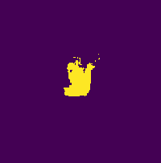
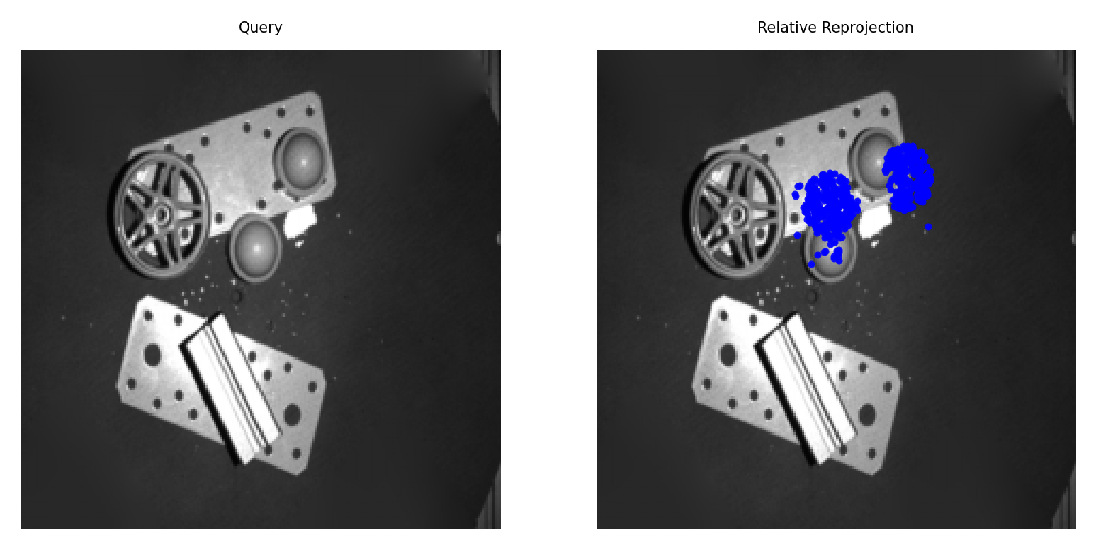
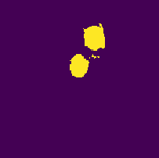
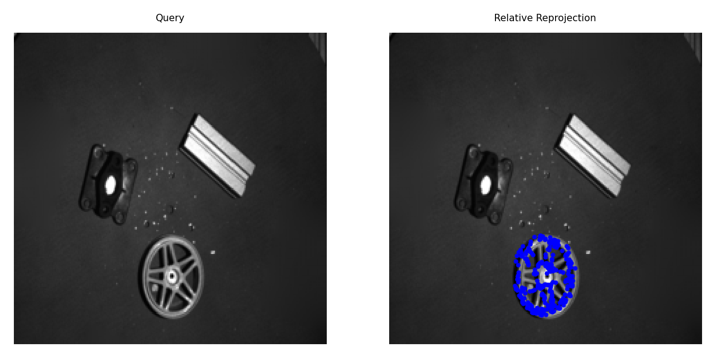
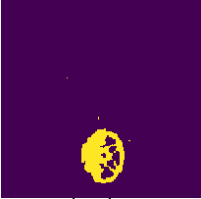
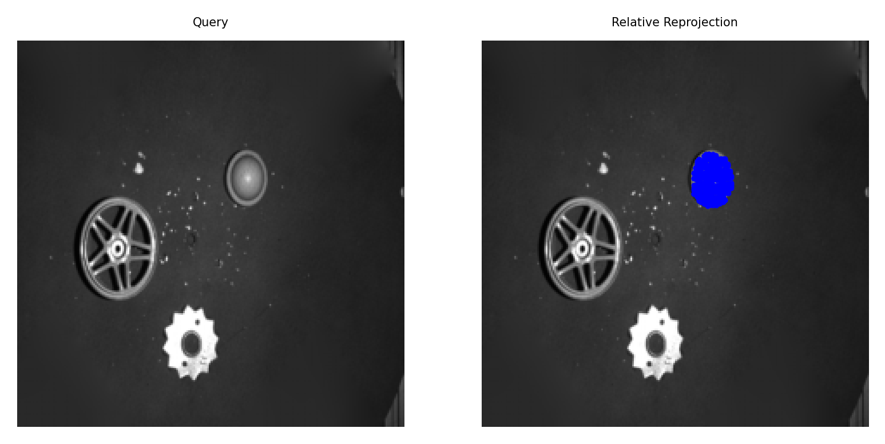
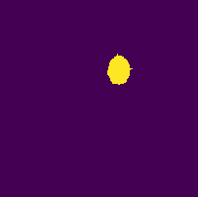
Quary
预测掩码
预测位姿
Quary
预测掩码
预测位姿
Prompt：engine part cooler round
Prompt：thin flat star-shaped metal part star
Quary
预测掩码
预测位姿
Quary
预测掩码
预测位姿
Prompt：long thin flat metal handle handle
Prompt：engine part cooler square
Quary
预测掩码
预测位姿
Quary
预测掩码
预测位姿
Prompt：engine part cover
Prompt：black metalscrew black
Quary
预测掩码
预测位姿
Quary
预测掩码
预测位姿
Prompt：black metal screw black
Prompt：small dome-shaped metal cap
Quary
预测掩码
预测位姿
Quary
预测掩码
预测位姿
Prompt：short metal cylinder with external threads
Prompt：small dome-shaped metal cap
Quary
预测掩码
预测位姿
Quary
预测掩码
预测位姿
Prompt：circular metal wheel rim
Prompt：small dome-shaped metal cap

